Slide 1
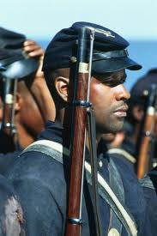
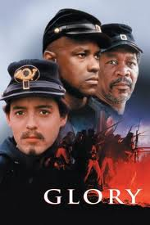
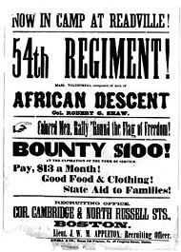
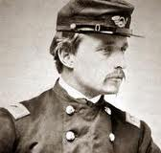
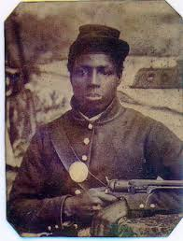
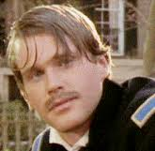
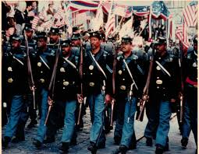
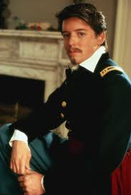
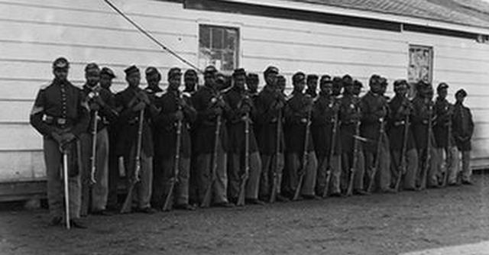
The 54th Massachusetts Regiment

Slide 2
Sloppy Copy
Who were the 54th?
When did the 54th fight?
What did the 54th do?
Civil
War
Topic
Why is the 54th important to the Civil War?
Where did the 54th fight?
Source 1:
Source 2:

Slide 3
Sloppy Copy
The 54th were the 1st African American Unit to fight in the Civil War
May 28th 1863 – End of the war
Helped the North Win The Civil War
54th
Massachusetts
Regiment
Proved that African Americans could fight just like whites, Paved the way for others to follow
Fort Wagner, James Island, South Carolina
Source 1 -http://www.masshist.org/online/54thregiment/essay.php?entry_id=528
Source 2 - http://www.black-hawk-design.net/wildwest/54Regement/page10.htm

Slide 4
Questions to answer on your graphic organizer
Who is important in your topic?
What is your topic all about?
Where did your topic take place?
When did your topic take place?
Why is your topic important to the Civil War?

Slide 5
Civil War Digital Notebook Checklist
Do You Have……..
Instruction Page and Sloppy Copy modified with questions changed and any notes that you have added to it.
2 Slides Completed
2 word documents that you have copied and pasted from your 2 resources and printed out. (See Example)
You are done!

